Slide 1
MIDDLETON CHENEY
FOOTBALL CLUB

Slide 2
FIRST TEAM
1952-53
SEASON
OXFORD JUNIOR LEAGUE
AND CUPS

Slide 3
April 4th 1953 Byfield Bethel Cup Final
Middleton 2 v 1 Stead & Simpson (Daventry)
S. Zaborski
H. Gibbard
G. Barnes
B. Tustain
R. Bennett
D. Gibbard Goal Scorers R. Christie
R. Christie H. Gibbard (Pen)
T. McMahon
L. Fox
R. Newman
S. Baker
Ref ?

Slide 4
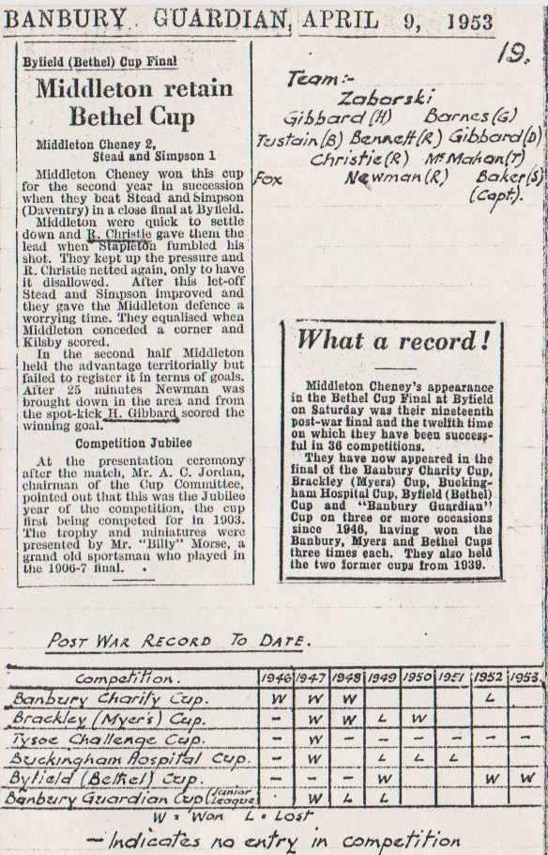

Slide 5
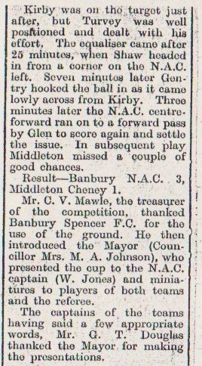
Banbury Guardian Report What Final ?

